Slide 1

moose for dcs world DESIGNATION

Slide 2
designation player experience

Slide 3
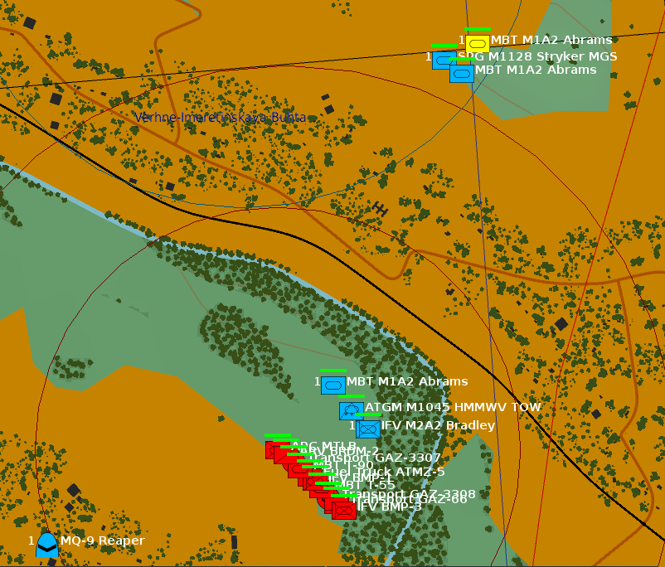
player experience: map view
Elevated Area
Observer
Ground Recce (RecceSet)
Line of Sight
Airborne Recce (RecceSet)
Targets (TargetSet)

Slide 4
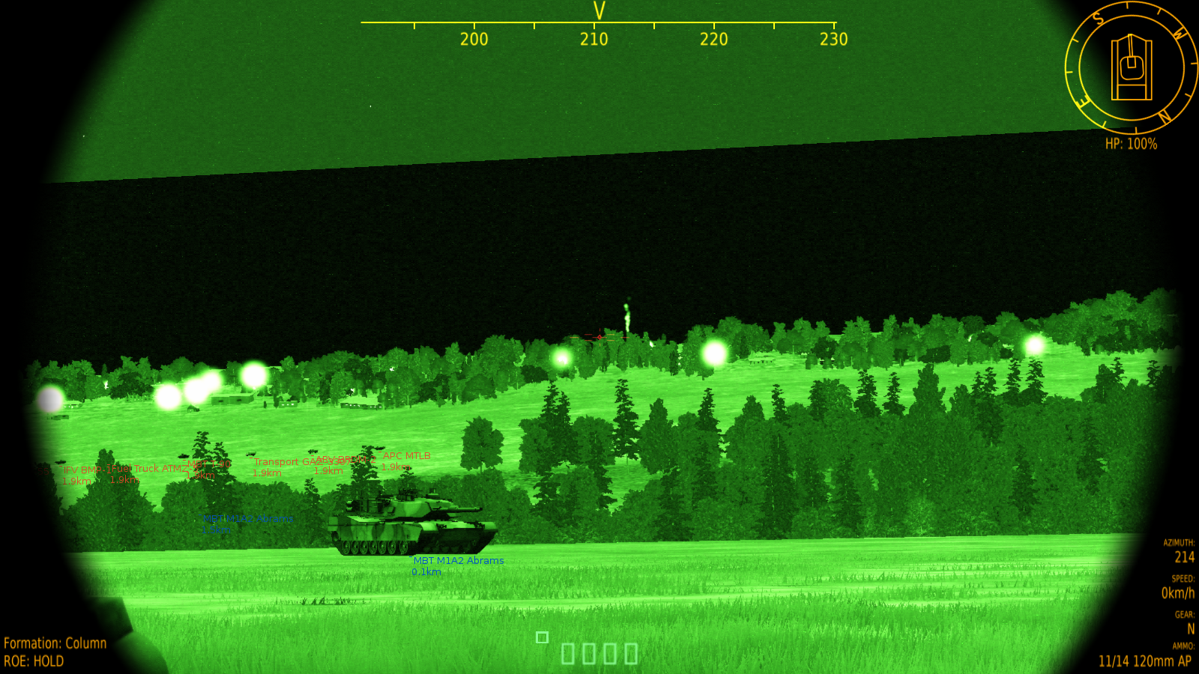
player experience: observer view
Targets have different threat levels.
The targets with the highest threat from an A2G perspective will be designated first!
Targets
Ground Recce

Slide 5
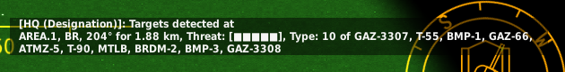
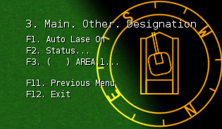
player experience: areas
Designation Main Menu
Upon detection of targets, an information panel shows per detected item: - Coordinate information - Threat level - Target information
A menu shows the current designation status per area. The ( ) will contain indicators: - “I” for Illumination designation - “S” for Smoking designation - “L” for Lasing designation
The designation types can be applied in parallel.
Auto lase will ensure that available targets are lased with a random selected laser code.

Slide 6
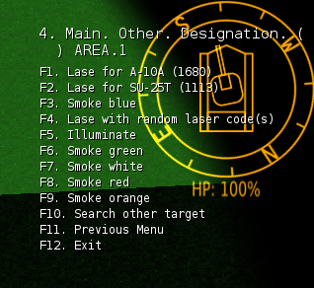
player experience: designate
Designation Area Menu
Each detected area menu has further options to lase, smoke or illuminate targets.
Note that lasing can be done for specific laser codes or with random laser codes.
Smoking can be done in blue, green, white, red or orange.
Other targets can be requested to be designated.

Slide 7
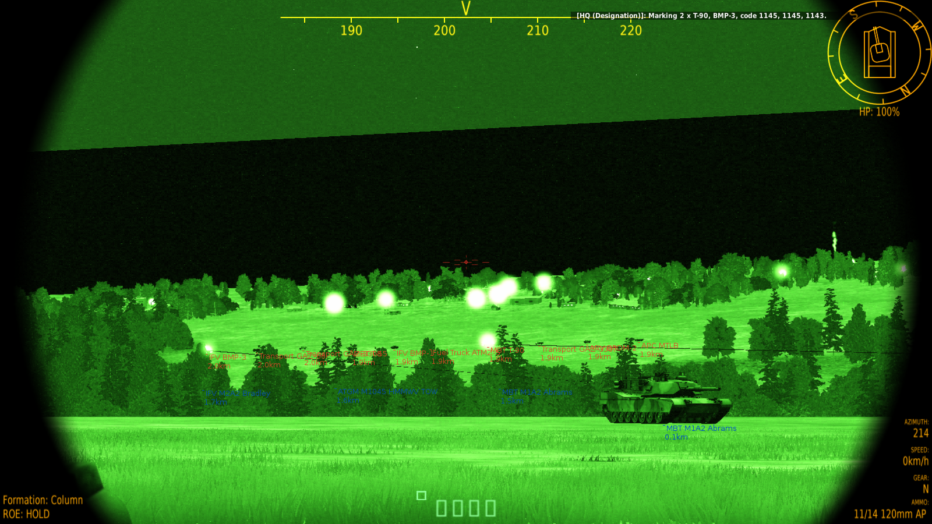
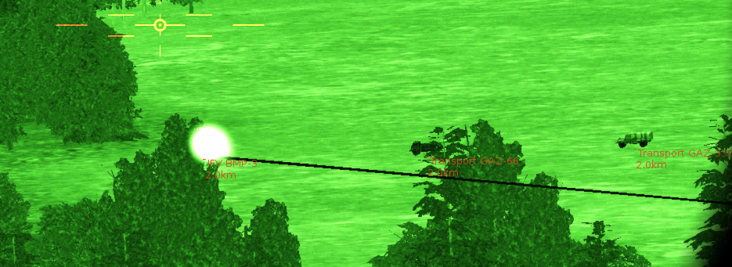
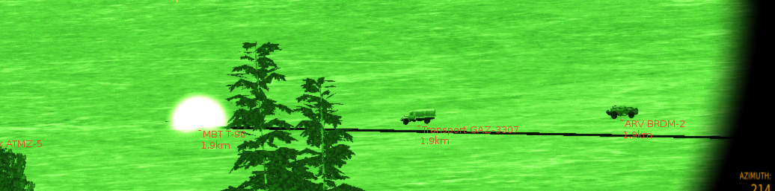
player experience: lasing
Lasing information (laser codes)
Recce lasing targets

Slide 8
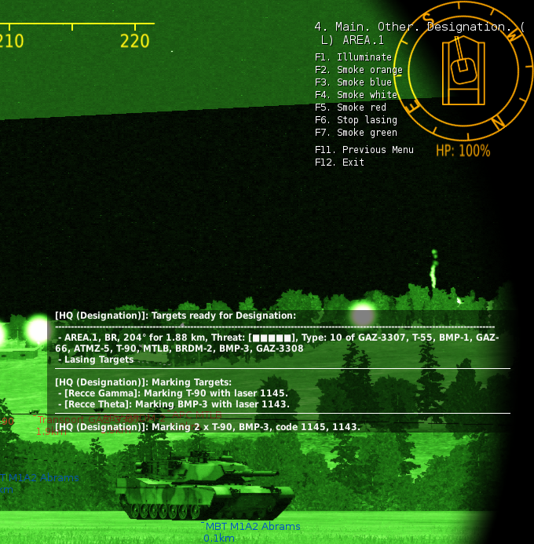
player experience: lasing
Auto lase will automatically select targets and lase continuously.
Auto lase will ensure that when targets are destroyed, new targets will be selected and lased.
Status Report
The status report shows for each designated area which targets are present and the designation actions currently active.
It provides details on laser codes being used.
The designation menu now has an option to stop lasing. The other lasing options are still available.

Slide 9
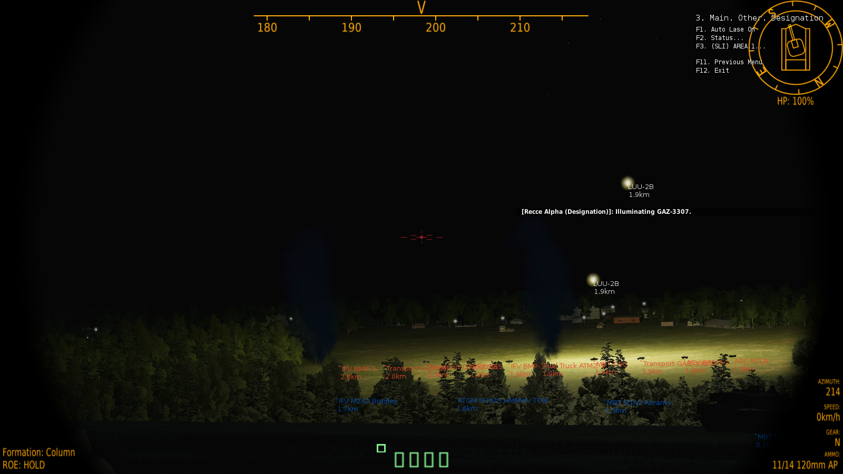
player experience: illumination
Illumination bombs are fired between 500 and 700 meters altitude and will burn about 2 minutes, while slowly decending.
Each available recce within range will fire an illumination bomb.
Illumination bombs can be fired in while lasing targets.
When illumination bombs are fired, it will take about 2 minutes until a sequent bomb run can be requested using the menus.
Illumination Bombs

Slide 10
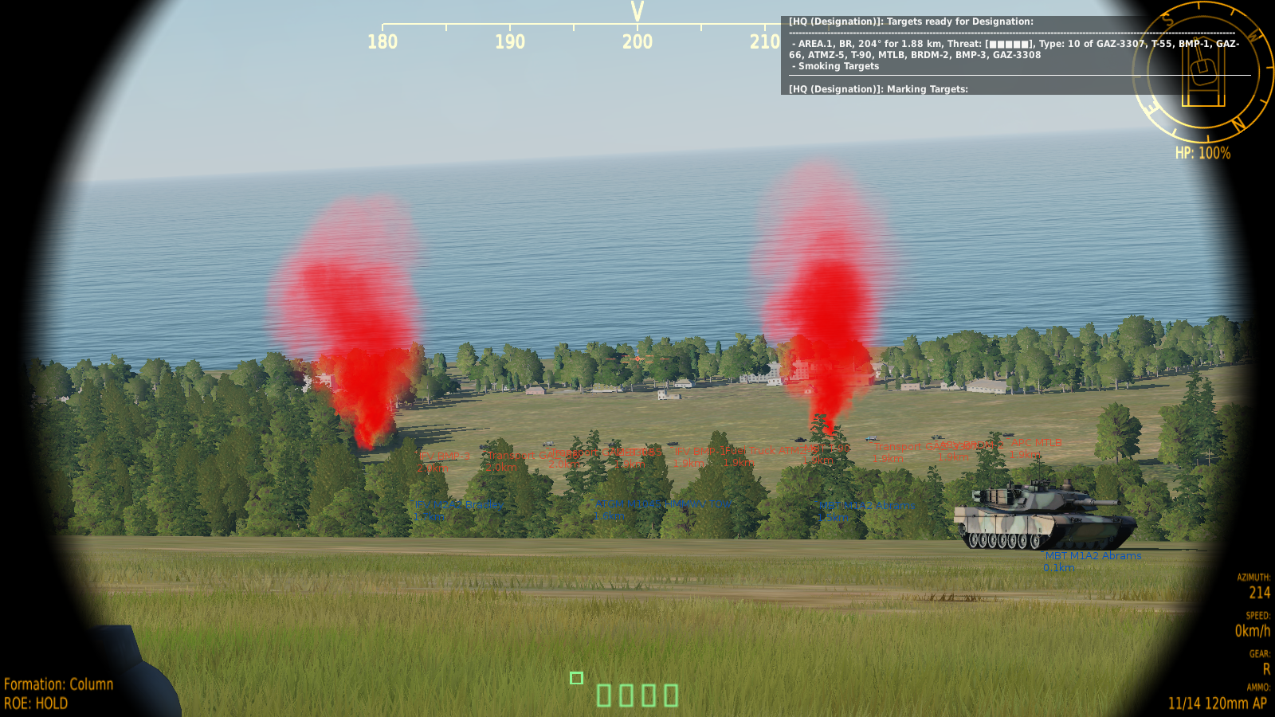
player experience: smoking
Smoke will fire for 5 minutes.
Each available recce within range will smoke a target.
Smoking can be requested while lasing targets.
Smoke will appear “around” the targets, because of accuracy limitations.
Smoke

Slide 11
designation per detection method

Slide 12
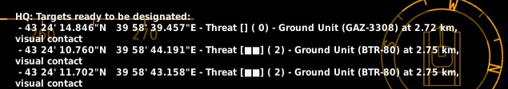
DESIGNATe: DETECTION
RecceSet 2
Functionalities
RecceSet 1
B
A
C
D
Multiple RecceSets (SET_GROUP) detect multiple TargetSets (SET_UNIT) by DETECTION_ classes.
Works with DETECTION_ classes, thus different detection grouping methods are supported:
PER UNIT => DETECTION_UNITS
TargetSet 1
TargetSet 2
TargetSet 3
TargetSet 5
TargetSet 4

Slide 13
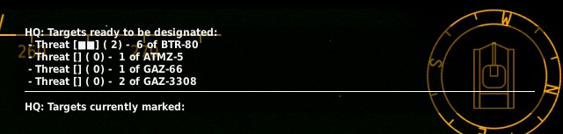
DESIGNATe: DETECTION
RecceSet 2
Functionalities
RecceSet 1
B
A
C
D
Multiple RecceSets (SET_GROUP) detect multiple TargetSets (SET_UNIT) by DETECTION_ classes.
Works with DETECTION_ classes, thus different detection grouping methods are supported:
PER TYPE => DETECTION_TYPES
TargetSet 1
TargetSet 2
TargetSet 3
TargetSet 4

Slide 14
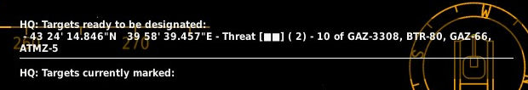
DESIGNATe: DETECTION
RecceSet 2
Functionalities
RecceSet 1
B
A
C
D
Multiple RecceSets (SET_GROUP) detect multiple TargetSets (SET_UNIT) by DETECTION_ classes.
Works with DETECTION_ classes, thus different detection grouping methods are supported:
PER AREA => DETECTION_AREAS
TargetSet 1
TargetSet 2

Slide 15
mark targets by laser

Slide 16
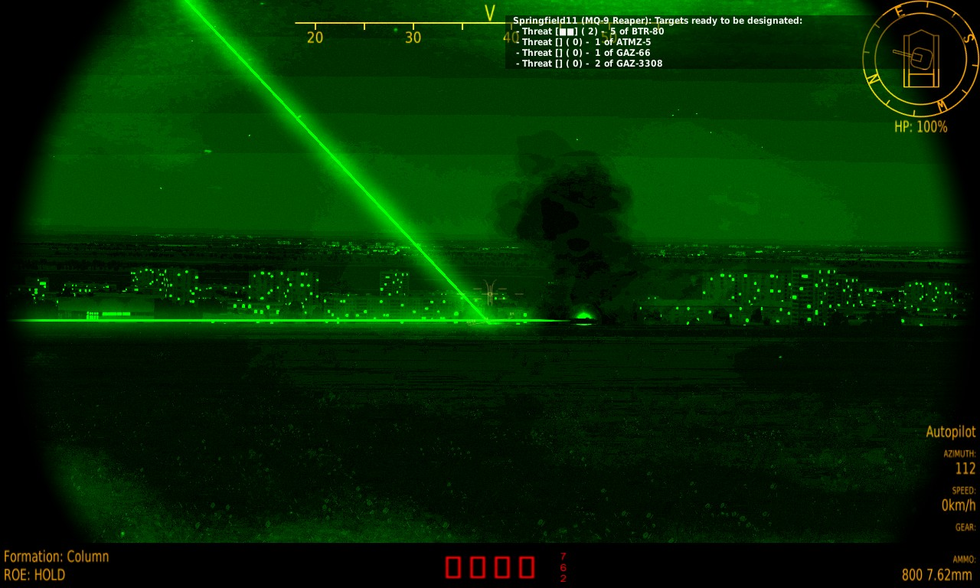
DESIGNATe: lasing
RecceSet 2
Functionalities
RecceSet 1
B
A
C
D
Lasing will try to let each Recce lase a Target. Try, because sometimes there aren’t enough laser codes available, or there aren’t enough Targets to be lased!
TargetSet 1
TargetSet 2

Slide 17
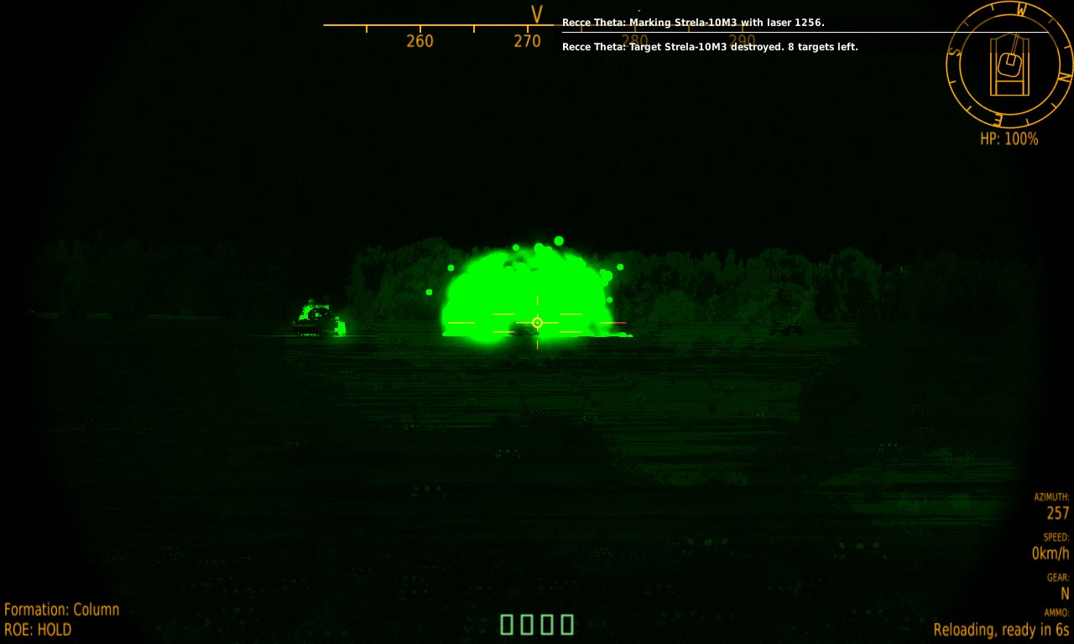
DESIGNATe: target destroyed
RecceSet 2
Functionalities
RecceSet 1
B
A
C
D
After a Target has been destroyed, a Recce will change Target automatically.
TargetSet 1
TargetSet 2

Slide 18
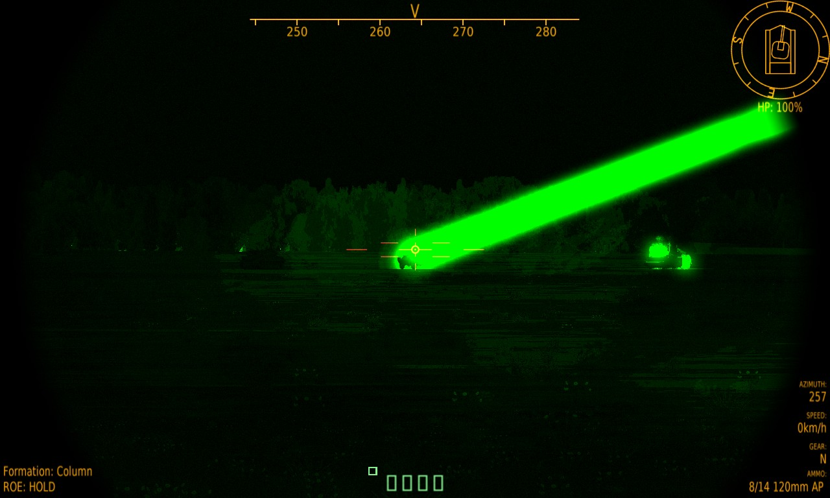
DESIGNATe: lase one targetset
RecceSet 2
Functionalities
RecceSet 1
B
A
C
D
Only one TargetSet can be lased specifically.
TargetSet 1
TargetSet 2

Slide 19
DESIGNATe: all targets destroyed
RecceSet 2
Functionalities
RecceSet 1
B
A
C
D
Once all Targets are destroyed of a TargetSet, the TargetSet will be removed from the Designation scope.
TargetSet 2

Slide 20
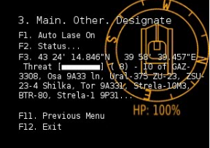
DESIGNATe: lasing remaining targets
RecceSet 2
Functionalities
RecceSet 1
B
A
C
D
Any remaining TargetSet can be activated to be Lased through the menu.
TargetSet 2

Slide 21
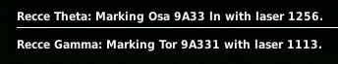
DESIGNATe: laser codes
RecceSet 2
Functionalities
RecceSet 1
B
A
C
D
Lasing can only be done with specific laser codes, which can be limited to one laser code available. In that case, only the amount of Recces will be selected as there are laser codes available. For example, the Su-25T can only lase with laser code 1113. So if only laser code 1113 can be used, then only ONE Recce will lase at the same time, athough there are 4 available! :SetLaserCodes() allows to set specific laser codes.
1113
TargetSet 2

Slide 22
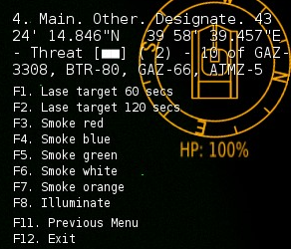
DESIGNATe: lasing duration
RecceSet 2
Functionalities
RecceSet 1
B
A
C
D
Lasing can be active for a specific duration. For example a Recce would only beam for about 120 seconds. After 120 it will stop beaming. In this case, an other Recce will beam to another available target.
1113
TargetSet 2

Slide 23
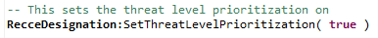
DESIGNATe: lasing
RecceSet 2
Functionalities
RecceSet 1
B
A
C
D
Prioritization based on Threat Level of the Targets can be achieved.
Use the method :SetThreatLevelPrioritization() to activate.
TargetSet 1
TargetSet 2

Slide 24
mark targets by smoke

Slide 25
DESIGNATe: smoking targets
RecceSet 2
Functionalities
RecceSet 1
B
A
C
D
Targets can be smoked in
Red
Blue
Green
White
Orange
Depending on the amount of targets, not all targets may be smoked… It is the “area” around the target that will be smoked…
TargetSet 1
TargetSet 2

Slide 26
mark targets through illumination

Slide 27
DESIGNATe: illuminating targets
RecceSet 2
Functionalities
RecceSet 1
B
A
C
D
Targets can be illuminated through an illumination bomb.
Depending on the amount of targets, not all targets will be illuminated… It is the “area” around the target that will lightened up…
TargetSet 1
TargetSet 2

Slide 28
status

Slide 29
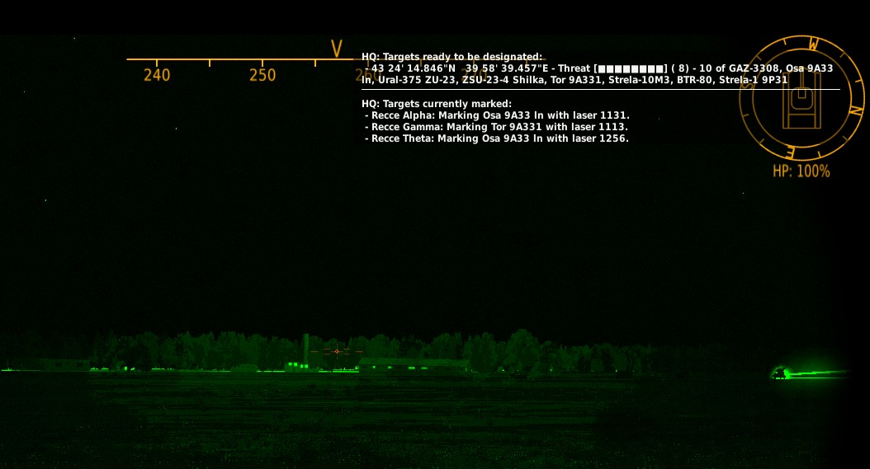
status report
Functionalities
The Head Quarters (the name of the Command Center is HQ) is reporting.
First, it shows the targets ready to be designated. In this example, grouping is done per AREA.
Second, the Targets that are currently marked are listed.

Slide 30
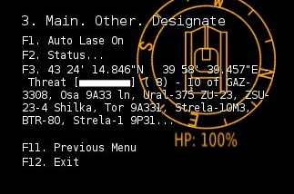
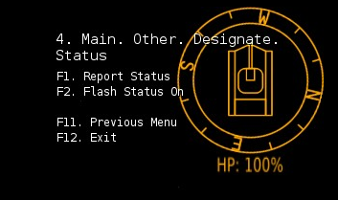
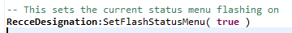
STATUS REPORT activation
Functionalities
The status report can be shown by selecting F1.
The status report can be flashed once a new detection has been done.
Note that by default the flashing of the status report is off, and can be activated through the Designation Menu (F2) or Programmatically.

